Slide 1
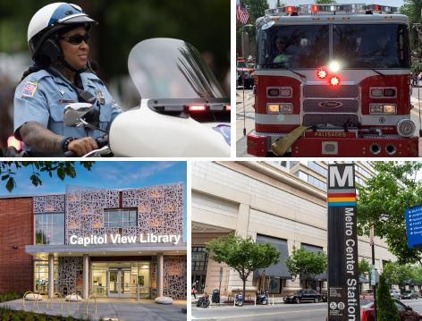
Residents Give District High Marks for City Services
November 4, 2019
Findings of a public opinion survey conducted
July 13–August 12, 2019

Slide 2
TABLE OF CONTENTS
TOP PROBLEMS IN THE CITY
EXECUTIVE
SUMMARY
FINDINGS
12
EVALUATION OF
CITY SERVICES
3
11
17
PRIORITY OF
CITY SERVICES
QUALITY OF INDIVIDUAL SERVICES
COMBINATION OF QUALITY AND PRIORITY
USE OF CITY SERVICES
21
26
30
31

Slide 3
EXECUTIVE SUMMARY

Slide 4
Methods
The 2019 D.C. resident study was conducted by Belden Russonello Strategists and Emma White Research via landline, cell phone, and online from July 13-Aug 13, 2019.
N=1,210 adult residents of Washington, D.C. (240 landline, 764 cell phone, 206 via opt-in online panel).
Data were weighted to ensure representativeness across the city and by ward, based on U.S. Census American Community Survey 2013-2017 estimates.
1997 comparisons are to a survey conducted by Belden & Russonello for the D.C. Financial Responsibility and Management Assistance Authority (N=1,200 residents).

Slide 5
Highlights: Overall
Overall, residents rate city services positively. Half rate city services as excellent or good (50%), and only one in eight rate services poor or very poor (13%).
This is a major improvement since 1997 when only 15% rated services excellent/good and nearly half (48%) said services were poor/very poor.
The cost of living/affordable housing/gentrification tops residents’ list of concerns, followed by crime. This also marks a distinct shift from 1997, when residents reported the dominant problem facing the city was crime/violence/drugs and nothing else came close.

Slide 6
Highlights: Individual services
Individual city services are also largely rated positively, with ratings for nearly all services higher than in 1997.
Highest quality ratings
Public libraries
Lowest quality ratings
Providing affordable housing
Fire protection
Art and cultural events and programs
Bus service
Services for people experiencing homelessness
Street repair and maintenance

Slide 7
Highlights: Priority services
Residents were asked to prioritize the same set of 26 services. Combined with quality ratings we can identify services residents see as important but underperforming.
Highest priorities
Quality of public schools across the city (45% top priority)
Safe drinking water (43%)
High priority and underperforming
Providing affordable housing
Services for people experiencing homelessness
Mental health services
Street repair/maintenance
Job training and placement for the unemployed
Drug treatment/recovery
Police protection
Police protection against crime (42%)
Providing affordable housing for residents (45%)
Services for people experiencing homelessness (39%)
Quality of public schools in your neighborhood (38%)
Quality of public schools across the city

Slide 8
Highlights: Use of services
Residents report largely positive experiences of 9-1-1 services and the DMV. Those who contacted the city about their taxes report more mixed experiences.
DMV
9-1-1
Contacting government about taxes
52% have contacted
65% of those report excellent/good service
26% have contacted
76% of those report excellent/good service
17% have contacted
40% report excellent/good service

Slide 9
Demographic change since 1997: education/race

Slide 10
Demographic change since 1997:
Income
*Source: inflation-adjusted figures from U.S. Census

Slide 11
FINDINGS

Slide 12
Top Problems in the City
What do you say is the most important problem facing people living in the District today? (OPEN-END, ONE RESPONSE ALLOWED)

Slide 13
Top Problems in the City by Gender, Age, Race

Slide 14
Top Problems in the City by Education, Income

Slide 15
Top Problems in the City by Homeownership, Tenure

Slide 16
Top Problems in the City by Ward

Slide 17
Overall Evaluation of City Services
*In considering city government services in the District, would you say the quality of public services in general is excellent, good, fair, poor or very poor?

Slide 18
Overall Evaluation of City Services by Gender, Race, Age
% “good” or “excellent”

Slide 19
Evaluation of Services by Income, Education, Rent/Own, Tenure
% “good” or “excellent”

Slide 20
Overall Evaluation of City Services by Ward
% “good” or “excellent”

Slide 21
Priority of City Services: Top Tier
* Now, I’d like to read the list again, but this time please tell me, if you were advising the District government, what kind of priority would you give to each of the following services: an extremely high priority, a high priority, a middle priority, a low priority, or an extremely low priority...(%
** Data is not available for some 1997 categories because it was not asked about in 1997 survey
*** 1997: Public schools

Slide 22
Priority of City Services: Middle Tier
* Now, I’d like to read the list again, but this time please tell me, if you were advising the District government, what kind of priority would you give to each of the following services: an extremely high priority, a high priority, a middle priority, a low priority, or an extremely low priority...(%
** Data is not available for some 1997 categories because it was not asked about in 1997 survey

Slide 23
Priority of City Services: Middle Tier Cont.
* Now, I’d like to read the list again, but this time please tell me, if you were advising the District government, what kind of priority would you give to each of the following services: an extremely high priority, a high priority, a middle priority, a low priority, or an extremely low priority...(%
** Data is not available for some 1997 categories because it was not asked about in 1997 survey

Slide 24
Priority of City Services: Bottom Tier
* Now, I’d like to read the list again, but this time please tell me, if you were advising the District government, what kind of priority would you give to each of the following services: an extremely high priority, a high priority, a middle priority, a low priority, or an extremely low priority….

Slide 25
Priority of City Services
Providing affordable housing for residents is generally a top issue across the city. These groups are especially likely to report affordable housing as a very high priority:
Renters
Newer residents;
Those who have annual household incomes between $50,000 and $100,000

Slide 26
Quality of City Services: Top Tier
*Please tell me if you think the quality of each of the following specific public services is excellent, good, fair, poor, or very poor?

Slide 27
Quality of City Services: Middle Tier
*Please tell me if you think the quality of each of the following specific public services is excellent, good, fair, poor, or very poor?
** Data is not available for some 1997 categories because it was not asked about in 1997 survey

Slide 28
Quality of City Services: Lower Tier
*Please tell me if you think the quality of each of the following specific public services is excellent, good, fair, poor, or very poor?
** Data is not available for some 1997 categories because it was not asked about in 1997 survey; ***1997: Public schools

Slide 29
Quality of City Services
All demographic groups ranked providing affordable housing and services for people experiencing homelessness as the lowest quality services in the city.

Slide 30
Priority by Quality
Low priority
High quality
High priority
High quality
Low priority
Low quality
High priority
Low quality

Slide 31
Use of City Services
In the last 12 months, residents have…

Slide 32
Experience contacting 9-1-1
Among those who have contacted within past 12 months
*When you contacted 911, would you say the service you received was excellent, good, fair, poor, or very poor? N=311

Slide 33
Experience regarding taxes
Among those who have contacted within past 12 months
*When you contacted District Government regarding taxes, would you say the service you received was
excellent, good, fair, poor, or very poor? N=201

Slide 34
Experience at DMV
Among those who have contacted within past 12 months
*When you contacted the District DMV, would you say the service you received was excellent, good, fair, poor, or very poor? N=632

Slide 35
Key Takeaways
The issues facing the city have changed.
  In 1997, crime dominated responses about the most important problem facing the city, but the next highest response – offered by more than one in ten – was that the DC government itself was the top problem (11%). This year the District government did not register as a problem or an issue.
  On the same question in 2019 the top issue cited was a combination of affordable housing and gentrification at 33 percent – and that issue did not register for respondents in 1997.
There is more consistency than divergence across subgroups in the city
  While we found some modest distinctions by age, gender, race and where people live, there was a significant degree of consistency on priorities and on the quality of District services. This was the case for those new to the District and for long-time residents.

Slide 36
Questions?
Emma White
Emma White Research
emma@whiteresearch.com
John Russonello
Belden Russonello
johnrussonello@brspoll.com

Slide 37
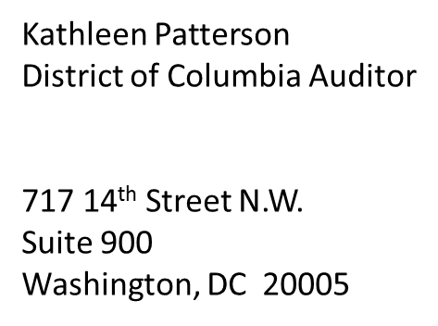
Call us: 202-727-3600
Get our updates: ODCA.mail@dc.gov
Tweet us: https://twitter.com/ODCA_DC
Visit us: www.dcauditor.org

Slide 38
About ODCA
The mission of the Office of the District of Columbia Auditor (ODCA) is to support the Council of the District of Columbia by making sound recommendations that improve the effectiveness, efficiency, and accountability of the District government.
To fulfill our mission, we conduct performance audits, non-audit reviews, and revenue certifications. The residents of the District of Columbia are one of our primary customers and we strive to keep the residents of the District of Columbia informed on how their government is operating and how their tax money is being spent.

